Slide 1
Early Career Teacher Entitlement (ECTE) Registration for the 2025/26 academic year
May 2025

Slide 2

Manage Training for Early Career Teachers Service
School nominates their induction tutor or logs in
Induction tutor selects the school’s delivery route for 2025
Providers confirm school’s delivery partner
Induction tutor registers ECTs and mentors
Information available to Providers
Choose between the 2 delivery routes or lets DfE know they do not expect to receive ECTs next year. If their provider relationship can be carried over from last year, this option is presented.
ECTs and mentors can be registered to the service. The service locates their central DfE record and assesses eligibility for training and funding. The service will automatically recognise the cohort and whether the participant is transferring or not.
All maintained schools invited by email to nominate the person responsible for organising induction in their school. If the school did this last year, the tutor can simply log in.
If a partnership has not been carried over from the previous year by the school, the Provider must report the partnership with the school. Schools receive an email notification of the partnership and can reject a partnership if they don’t recognise it.
Information is made available to lead providers via the API. Lead providers are responsible for passing information on to their delivery partners and setting up access to training.
1
2
3
4
5
Steps 3 and 4 can happen independently of each other and in either order.
However, both steps must happen for Step 5 to occur.

Slide 3
ECTE Registration AY2025/26
The following videos will demonstrate:
how a school nominates an Induction Tutor
how an Induction Tutor notifies DfE of their programme choice for the 2025/26 academic year
how an Induction Tutor registers an early career teacher (ECT) and mentor who are commencing their ITTECF-based training from September 2025
how an Induction Tutor transfers in an ECT from another school
how an Induction Tutor assigns a mentor to an ECT
how an Induction Tutor amends the details of an ECT or Mentor

Slide 4
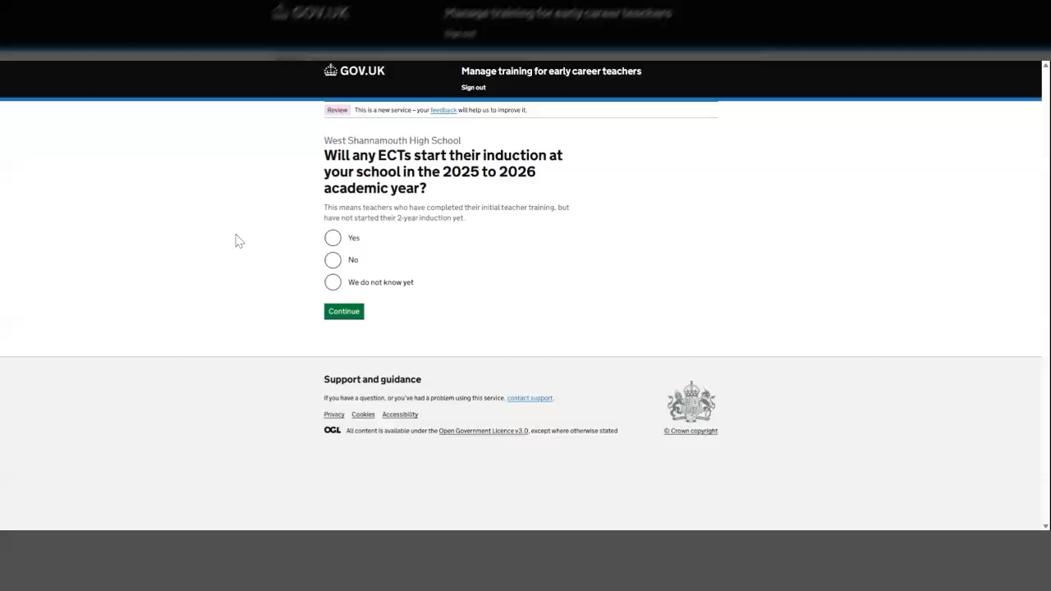
How to nominate an Induction Tutor

Slide 5
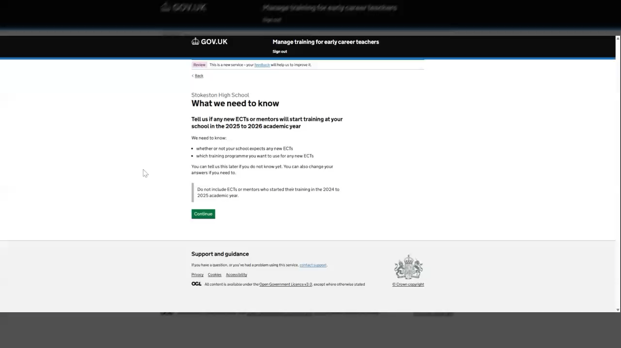
Programme selection for the 2025/26 academic year

Slide 6
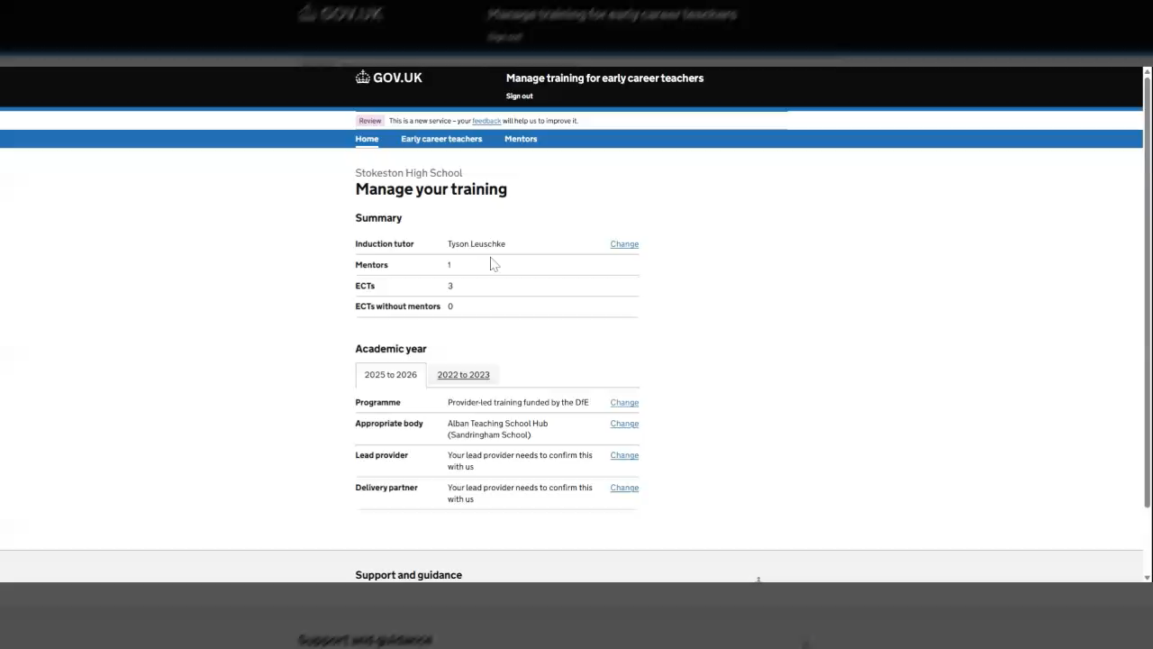
Register an ECT starting training from AY2025/26

Slide 7

Register a mentor starting training from AY2025/26

Slide 8
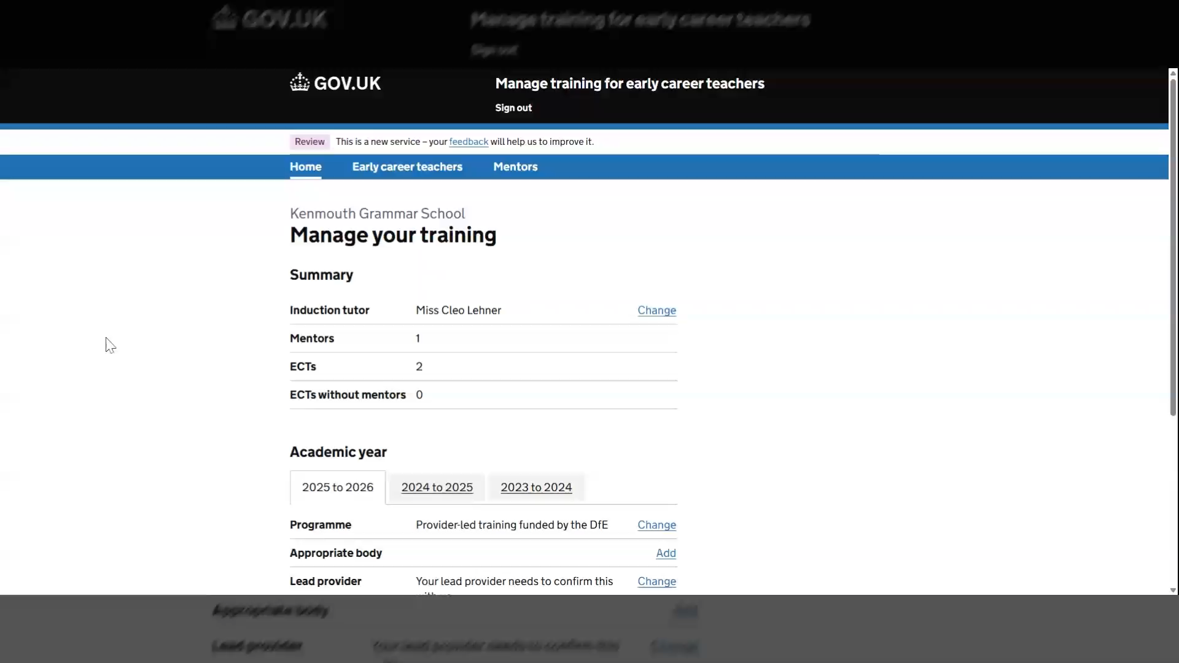
ECT Transferring from another school

Slide 9
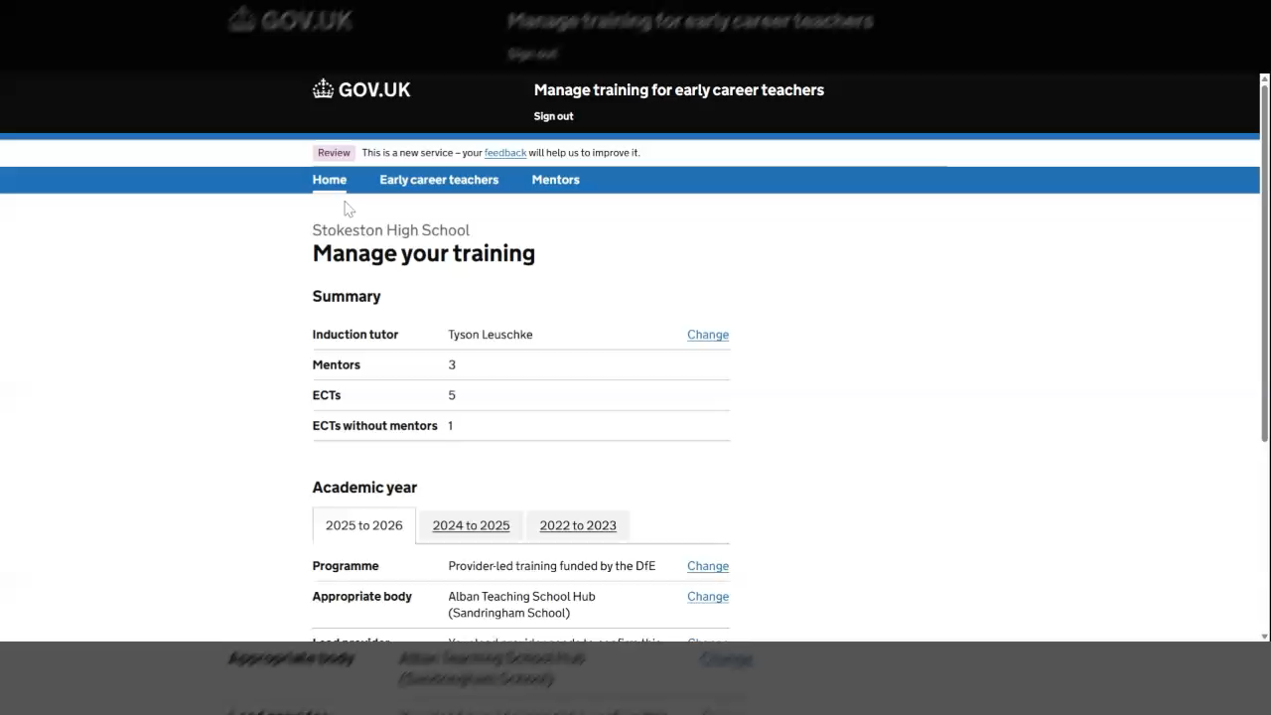
Assign a mentor to an ECT

Slide 10
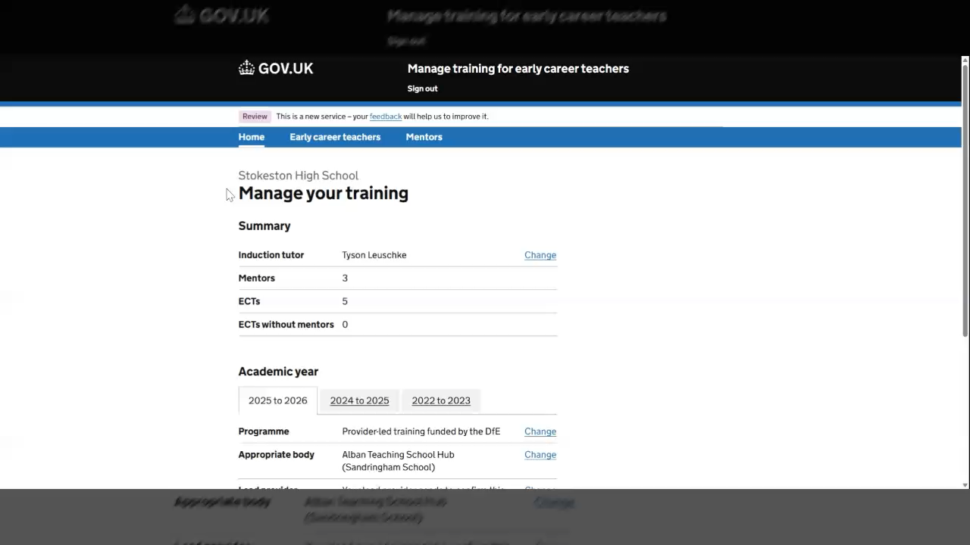
Amend an ECT or mentor information

Slide 11
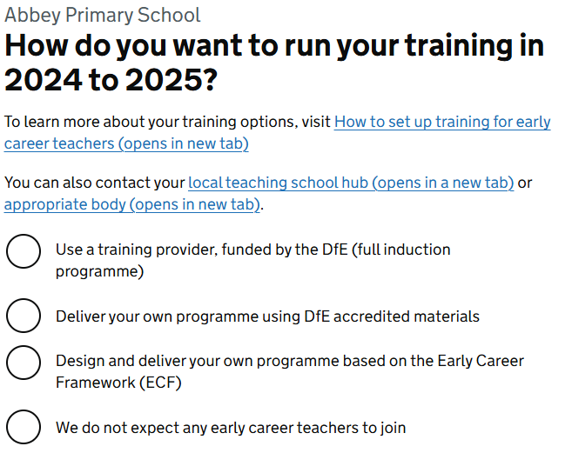
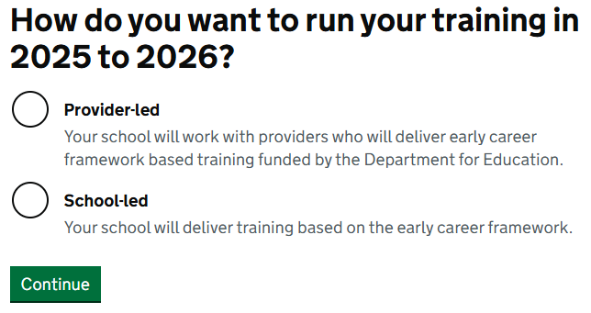
Changes to programme types for AY2025/26
As part of the changes for the 2025/26 academic year, the DfE have simplified the programme types, and Induction Tutors will now be presented with two options rather than the previous three:
Provider-led
School-led
This change was made to simplify the journey and is more aligned with the mental model that schools have for ECTE training.
The changes are backward facing and have been applied across all the previous cohorts.
New Terminology
Old Terminology

Slide 12
Next Steps
w/c 16th June 2025
A selection of schools will be invited to set up their ECTE for the 2025/26 academic year and register ECTs and/or mentors as part of a 'soft launch’.
We will focus these invites on schools that are going to be working with a new lead provider in the 2025/26 academic year, as these will not be able to self serve and ‘rollover’ their previous partnership.
w/c 30th June 2025
All schools will receive an invite to set up their ECTE for the 2025/26 academic year and register ECTs and/or mentors.

